Slide 1

APACHE KAFKA
Roshni Dhakate

Slide 2

Agenda
What is Kafka
Kafka Components
Topics and Brokers
Kafka Vs RabbitMQ
Demo
Basic Cli Commands
Topics and partition

Slide 3
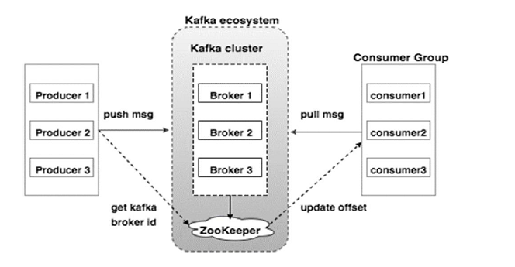
What Is KaFka
Distributed publish-subscribe messaging system that receives data from source systems and makes the data available to target systems in real time.
Primarily used to build real-time streaming data pipelines and applications that adapt to the data streams.

Slide 4
Kafka Components
Broker: Kafka cluster typically consists of multiple brokers to maintain load balance. Kafka brokers are stateless, so they use ZooKeeper for maintaining their cluster state. Kafka broker leader election can be done by ZooKeeper.
ZooKeeper: It is used for managing and coordinating Kafka broker. ZooKeeper service is mainly used to notify producer and consumer about the presence of any new broker in the Kafka system or failure of the broker in the Kafka system. As per the notification received by the Zookeeper regarding presence or failure of the broker then pro-ducer and consumer takes decision and starts coordinating their task with some other broker.
Producers: It push data to brokers. When the new broker is started, all the producers search it and automatically sends a message to that new broker. Kafka producer doesn’t wait for acknowledgements from the broker and sends messages as fast as the broker can handle.
Consumers : Kafka brokers are stateless, which means that the consumer has to maintain how many messages have been consumed by using partition offset. If the consumer acknowledges a particular message offset, it implies that the consumer has consumed all prior messages. The consumers can rewind or skip to any point in a partition simply by supplying an offset value. Consumer offset value is notified by ZooKeeper.

Slide 5
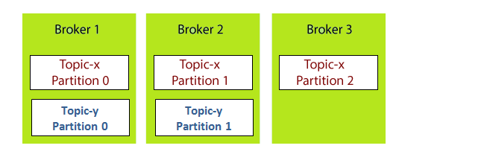
Brokers and Topics

Slide 6
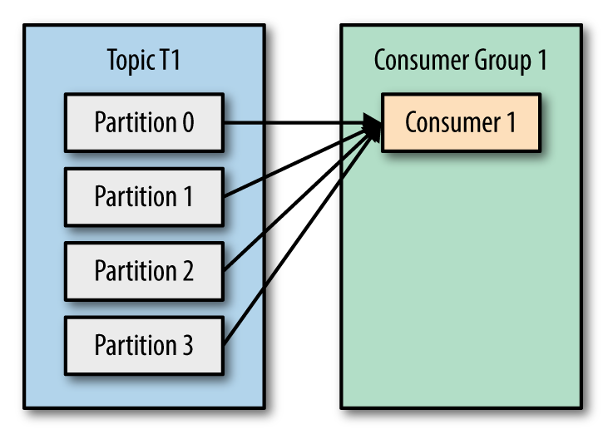
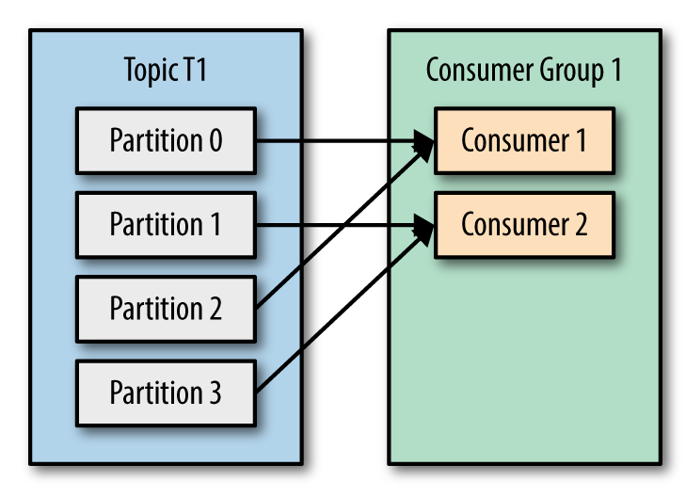
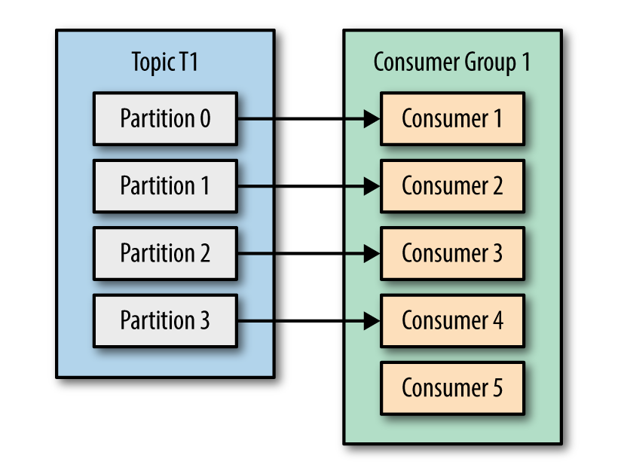
Topics AND Consumers

Slide 7
Kafka Vs RabbitMq
Tool | Apache Kafka | RabbitMQ
Message ordering | provides message ordering. Messages are sent to topics | Not supported.
Message lifetime | Kafka is a log, which means that it retains messages by default. You can manage this by specifying a retention policy. | RabbitMQ is a queue, so messages are done away with once consumed, and acknowledgment is provided.
Delivery Guarantees | Retains order only inside a partition. In a partition, Kafka guarantees that the whole batch of messages either fails or passes. | Doesn’t guarantee atomicity, even in relation to transactions involving a single queue.
Message priorities | N/A | In RabbitMQ, you can specify message priorities and consume message with high priority first.

Slide 8
Basic CLI Commands
Inside main folder kafka
For zookeeper start:
.\bin\windows\zookeeper-server-start.bat .\config\zookeeper.properties
For Kafka Server:
.\bin\windows\kafka-server-start.bat .\config\server.properties
inside windows folder : kafka\bin\windows
kafka-topics.bat --create --topic topicFromCmd --bootstrap-server localhost:9092
kafka-topics.bat --create --topic topicFromCmd --bootstrap-server localhost:9092 --partitions 2 --replication-factor 1
kafka-topics.bat --describe --topic topicFromCmd --bootstrap-server localhost:9092
kafka-topics.bat --describe --bootstrap-server localhost:9092
kafka-console-consumer.bat --topic testTopic1 --from-beginning --bootstrap-server localhost:9092

Slide 9

Thank You

